Slide 1
ML implemented predictive analysis of CO₂ adsorption onto polymeric materials having high N (wt% > 8) content
Functional Materials Laboratory
Department of Chemistry
Kevin Joel Supervisor
19310014 Prof. P. Mohanty

Slide 2


Introduction
Increasing population and continuous use of fossil fuel lead to an increase in the carbon dioxide (CO₂) concentration (410 ppm to 415 ppm) in the atmosphere [1], which contribute to the major increment in global warming and climate change.
The major consequences of global warming to the environment, lead to an increment in the seawater level, typhoons, tropical storms, parchedness, and ill health for the people.
Image source: pexels.com
[1] Global Monitoring Laboratory, Earth System Research Laboratories, Trends Atmos. Carbon Dioxide, (2022)

Slide 3
Introduction
Measures Taken for CO₂ reduction in the atmosphere:
The Department of Energy (DOE), United States, has already taken a step back in 2009 to capture 90% of environmental CO₂ with an expenditure of not more than 35%. [2]
For the reduction of CO₂ concentration in the atmosphere, carbon capture and storage (CCS) technology got the most attention in combating global climate change. [3]
The CCS technology is considered as expensive procedure because of being CO₂ capture as cost determining step that has part of more than 50% of the total cost of CCS. [4]
CO₂ adsorption through porous carbons is a fruitful procedure because adsorbent can be restored and having low cost operations. [4]
Ref:
[2] J.P. Ciferno, T.E. Fout, A.P. Jones, J.T. Murphy, Capturing carbon from existing coal-fired power plants, Chem. Eng. Prog. 105 (4) (2009) 33.
[3] X. Yuan, M. Suvarna, S. Low, P.D. Dissanayake, K.B. Lee, J. Li, X. Wang, Y.S. Ok, Applied machine learning for prediction of CO2 adsorption on biomass waste-derived porous carbons, Env. Sci. Technol. 55 (17) (2021) 11925–11936
[4] X. Yuan, J.G. Lee, H. Yun, S. Deng, Y.J. Kim, J.E. Lee, S.K. Kwak, K.B. Lee, Solving two environmental issues simultaneously: Waste polyethylene terephthalate plastic bottle-derived microporous carbons for capturing CO2, Chem. Eng. J. 397 (2020), 125350.

Slide 4
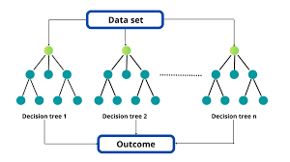
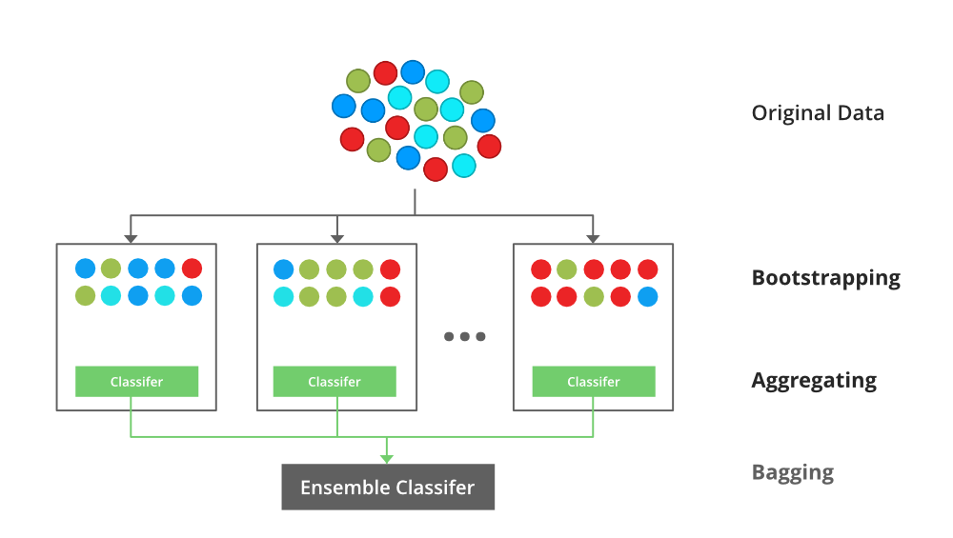
Introduction
Machine Learning for Adsorption Predictive Analysis :
Machine learning (ML), an emerging mathematically advanced tool, is getting more attention to deal with a large amount of data-driven complex problems (i.e.,predictive analysis, natural language processing, image analysis, language translation).
ML has been used widely in both fields of adsorption (liquid phase and gas phase).
Yuan et al. [5] demonstrated the application of ML models (tree-based models-GBDT, LBGM, and XGB) to predict the CO₂ uptake in biomass waste-derived porous carbons.
[5] X. Yuan, J.G. Lee, H. Yun, S. Deng, Y.J. Kim, J.E. Lee, S.K. Kwak, K.B. Lee, Chem. Eng. J. 397 (2020), 125350.

Slide 5
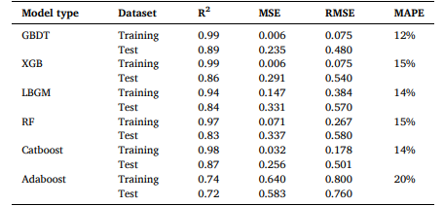
Introduction
Namdeo et al. [6] implemented and compared 6 ML models (GBDT, XGB, LBGM, RF, Catboost, and Adaboost) to predict the adsorption behaviour of porous carbons towards CO₂ adsorption.
In this paper the black box nature of ML interpretation was used for creating predictive models on CO₂ adsorption data.
Below is the accuracy of the analysis on holdout test-data of the models in different metrics. (Highest R² accuracy = 0.89).
Input features:
BET Surface Area (m² g⁻¹)
Total Pore Volume (cm³ g⁻¹)
Micro Pore Volume (cm³ g⁻¹)
Elemental Analysis (C,H,N,O wt%)
Temperature (◦C)
Pressure (bar)
Output Variable:
CO2 Uptake (mmol g⁻¹)
[6] Namdeo,S; Srivastava, V. C.; Mohanty, P. J. Colloid Interface Sci., 647 (2023), 174.

Slide 6
Research Target
In the paper by Namdeo et al. the predictive modelling is done for all types of porous carbon materials.
The goal of this project is to perform predictive modelling on data collected for polymeric porous materials having high Nitrogen weight percentages (N >= 8 wt%).
The following attributes are taken into consideration while collecting data from papers:
Material Type (Microporous, Mesoporous or Hierarchical).
BET Surface Area (m² g⁻¹)
Total Pore Volume (cm³ g⁻¹)
Elemental Analysis (C,H,N,O in wt%)
Temperature (◦C)
Pressure (bar)
CO₂ Uptake (mmol g⁻¹)
On collecting sufficient number of data points, modelling is performed using different ML ensemble methods.

Slide 7
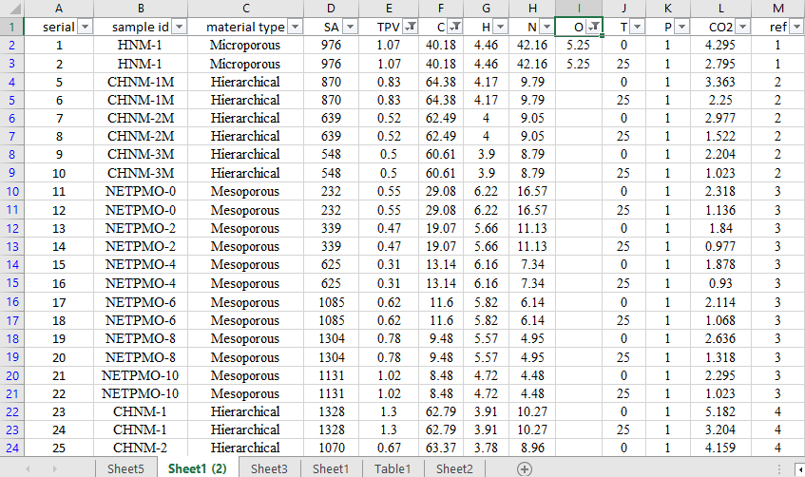
Observations
The following table below shows few of data points out of 275 collected.
The data has missing values at random.
The data has uneven scaling and that may cause model to have bias.
To handle Missing values KNN imputation technique is implemented.
To scale the data Standard Scaler is used.

Slide 8
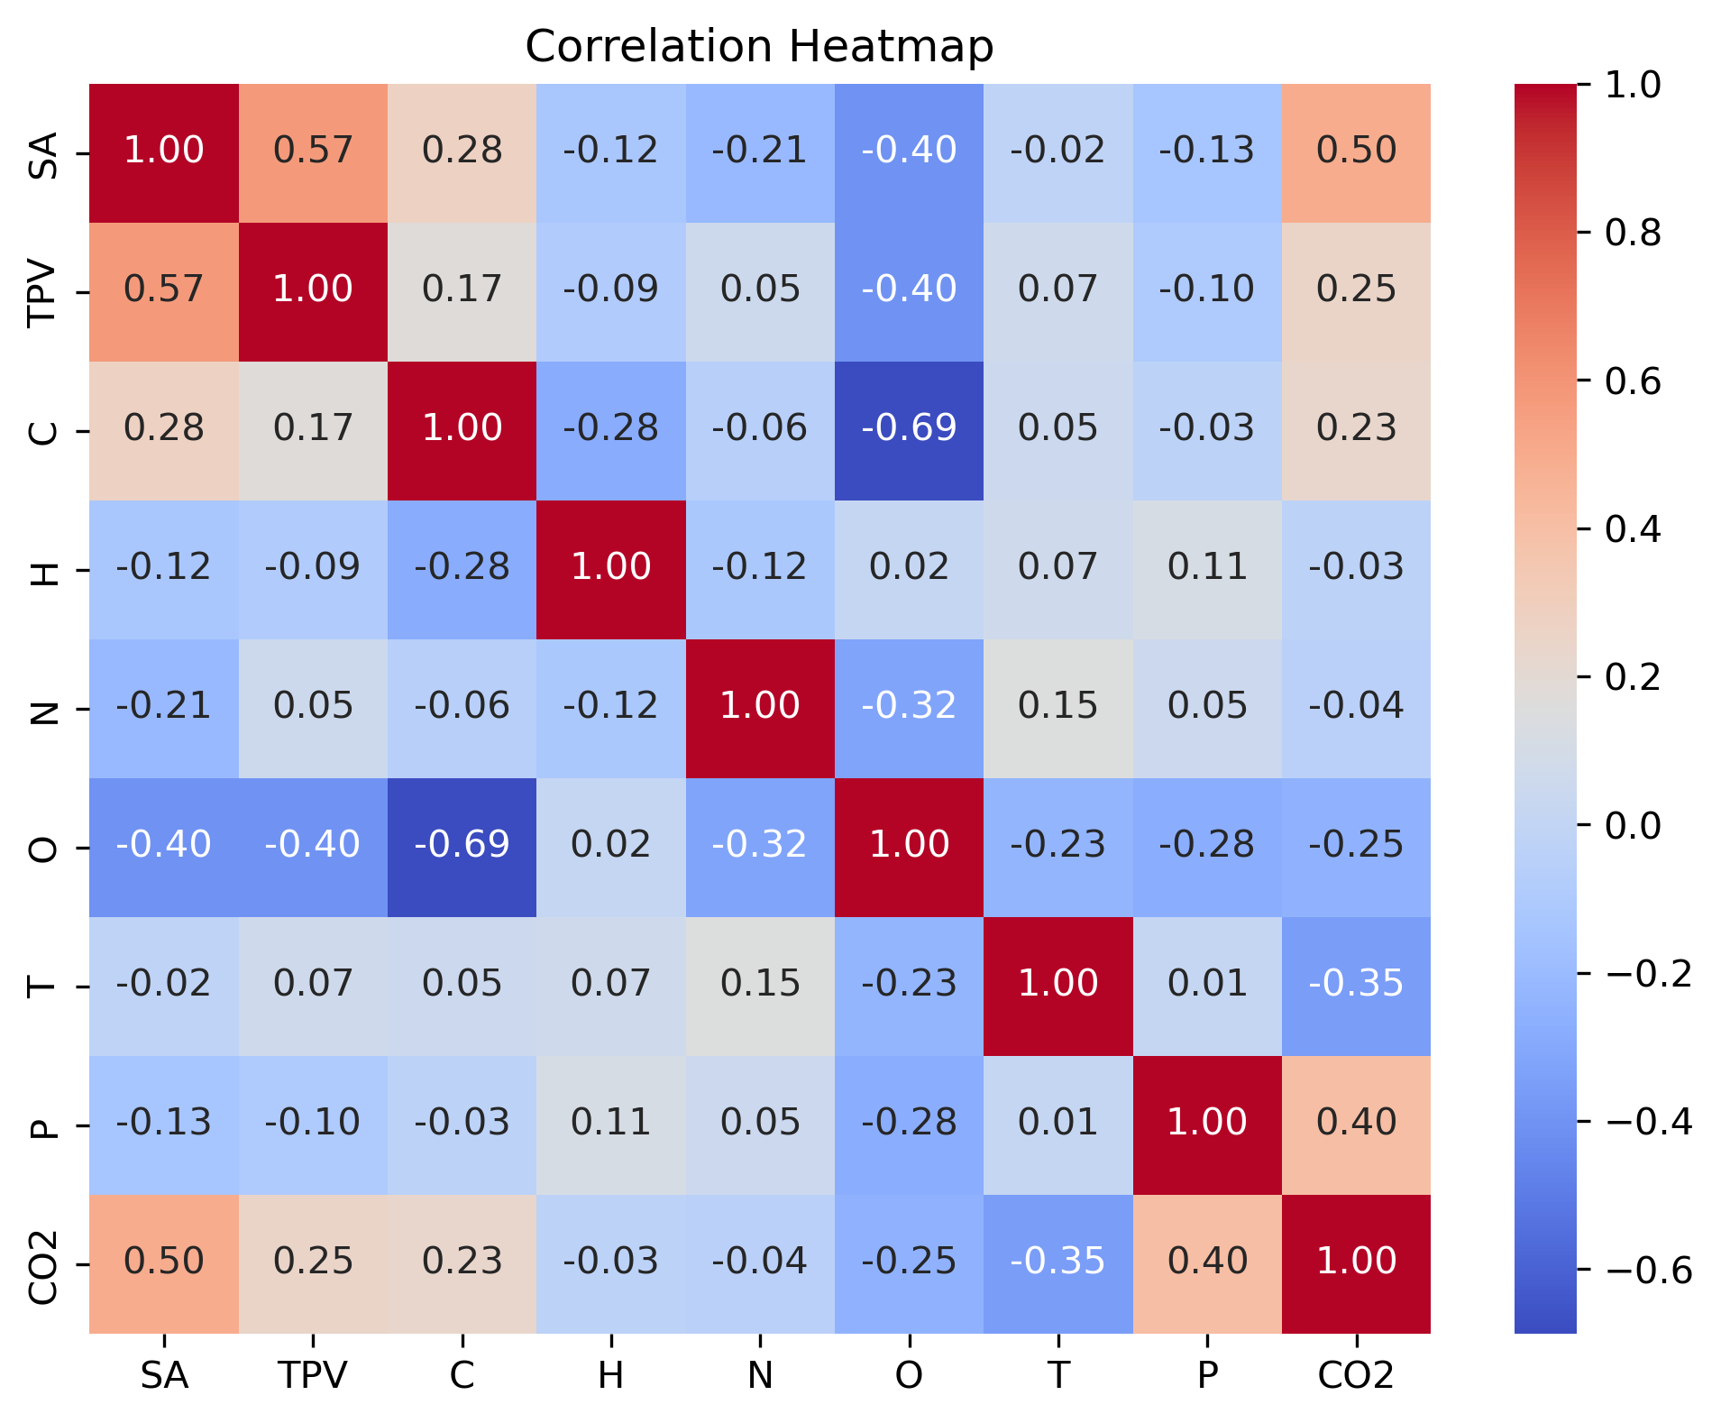
Observations
Further analysis using Pearson Correlation Matrix of the data we get an idea of how all the attributes (Material type, TPV, etc.) are related to our target variable CO₂.
The transformed and scaled data to train different ML models. Catboost, xgboost, LGBM, etc. to name a few…
On model training the highest test R² accuracy was given by catboost (0.71).
Fine-tuning these models resulted in higher test R² accuracy of 0.886.

Slide 9
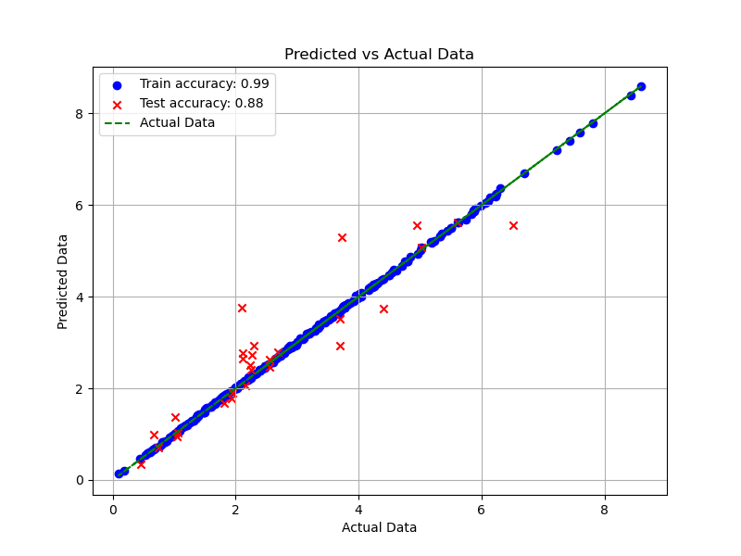
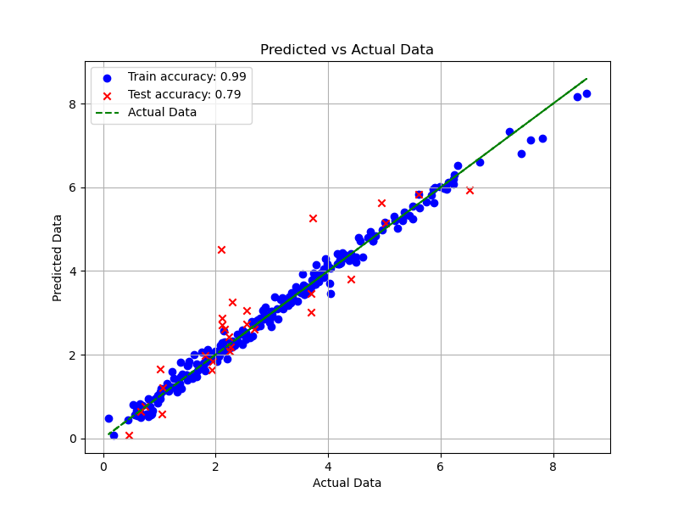
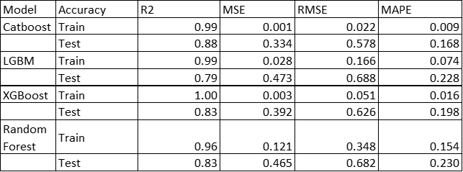
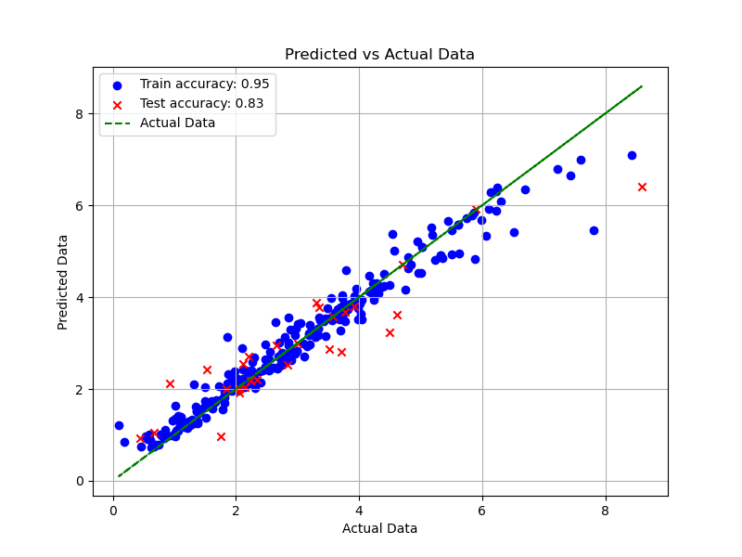
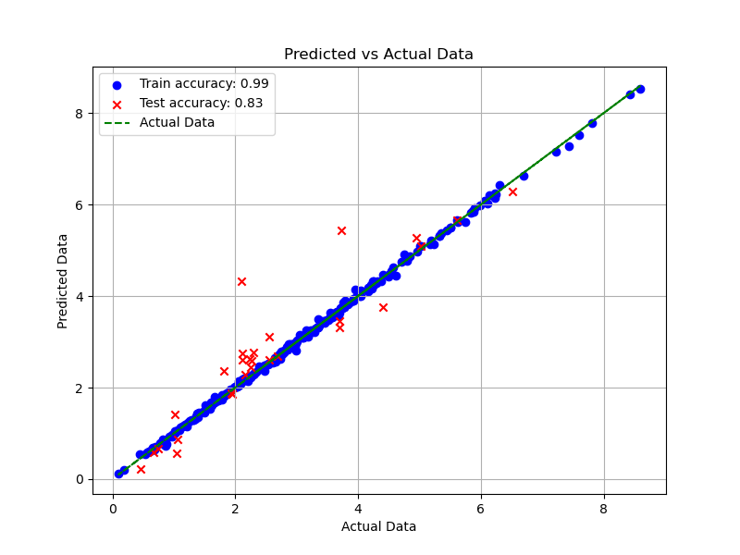
Results
Catboost
LGBM
The above table shows the different model performance on the same set of data.
Both train and test data in the ratio 9:1.
Random Forest
XGBoost

Slide 10
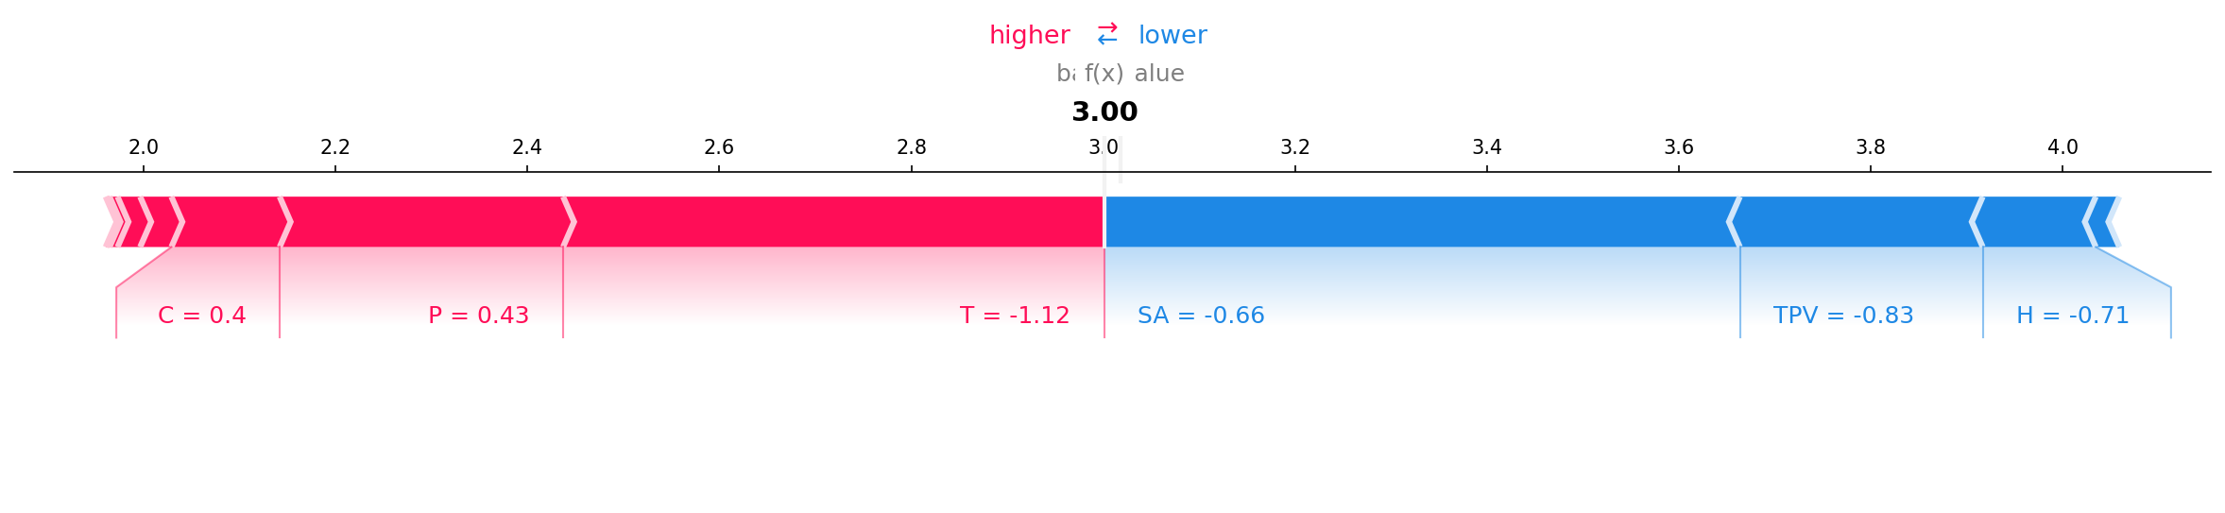
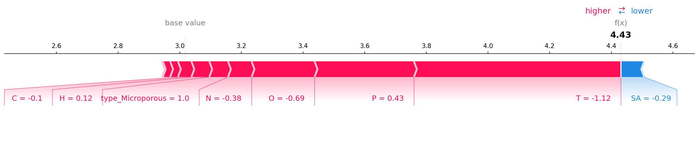
Results
Force Plot for Point 1
Force Plot for Point 2

Slide 11
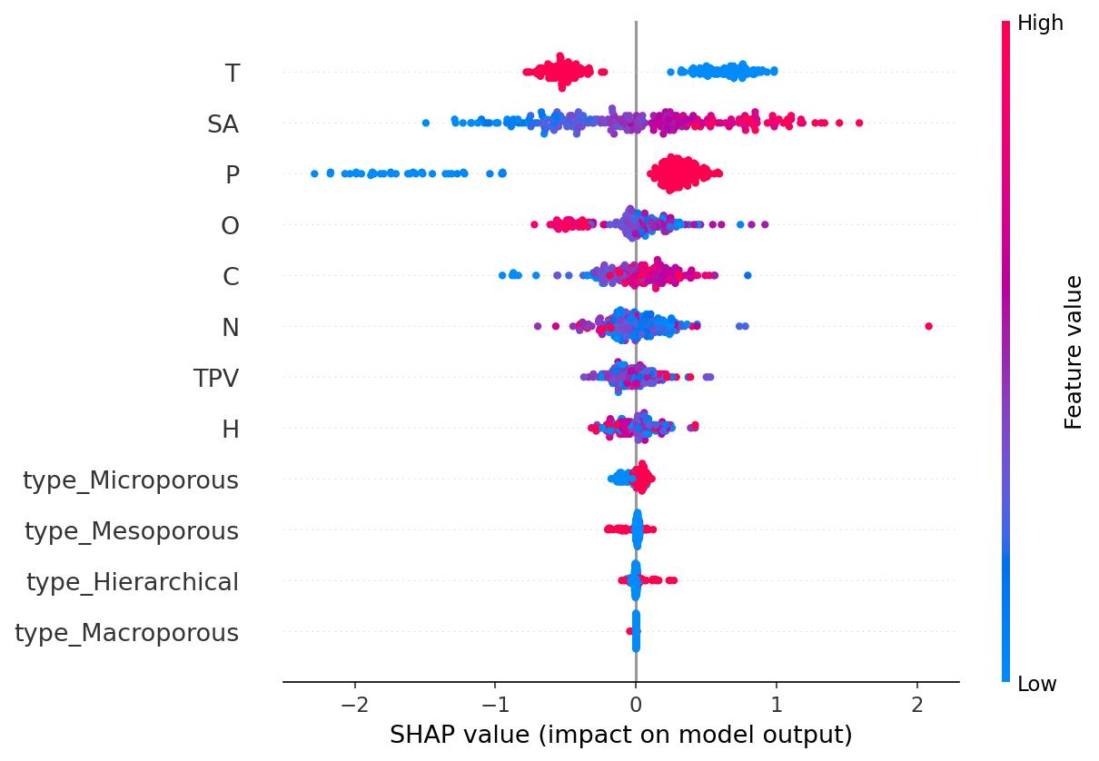
Result
Beeswarm Plot for analysis of trained catboost model against attributes contributions.

Slide 12
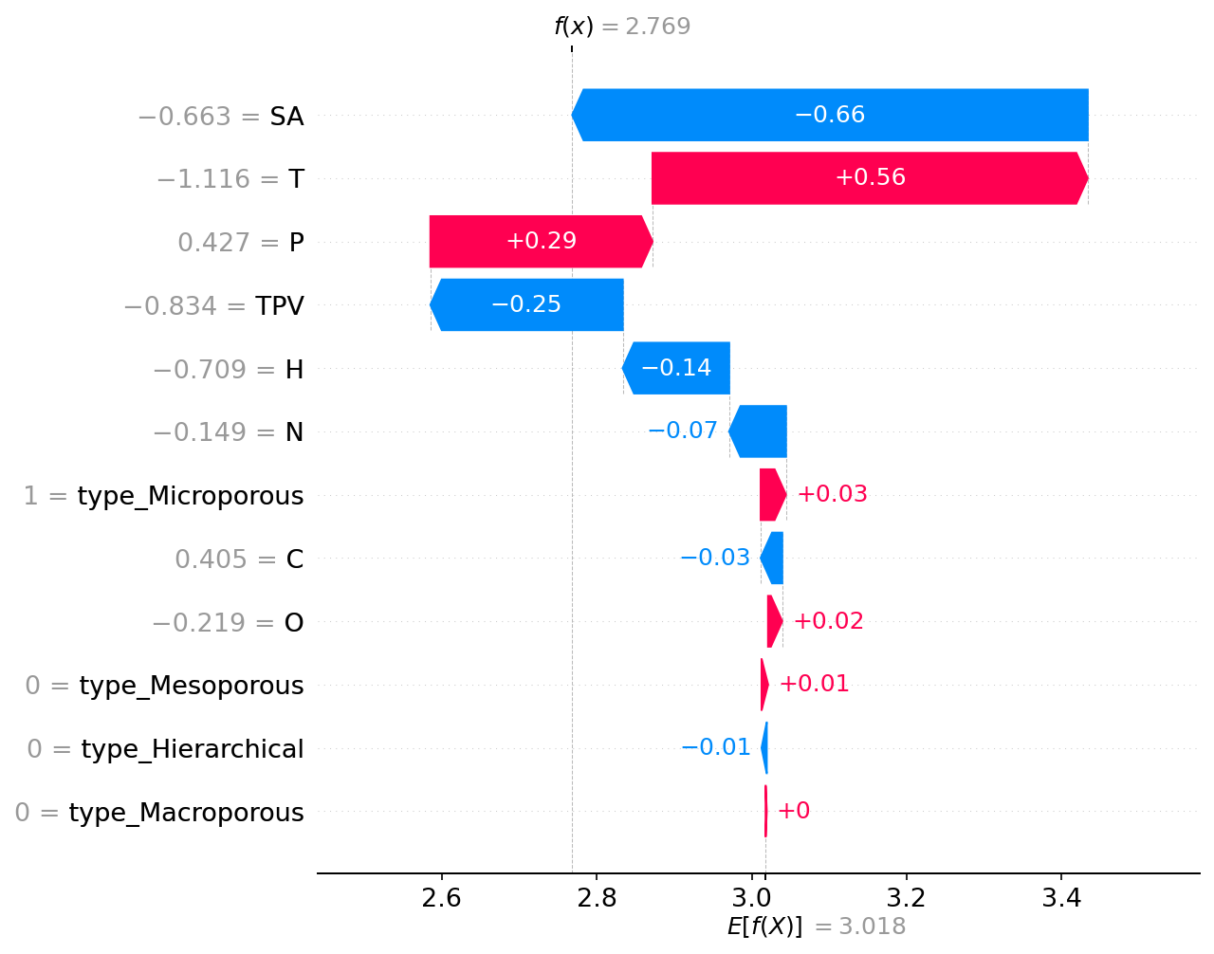
Result
Waterfall plot showing dependence of one target value with it determining factors.

Slide 13
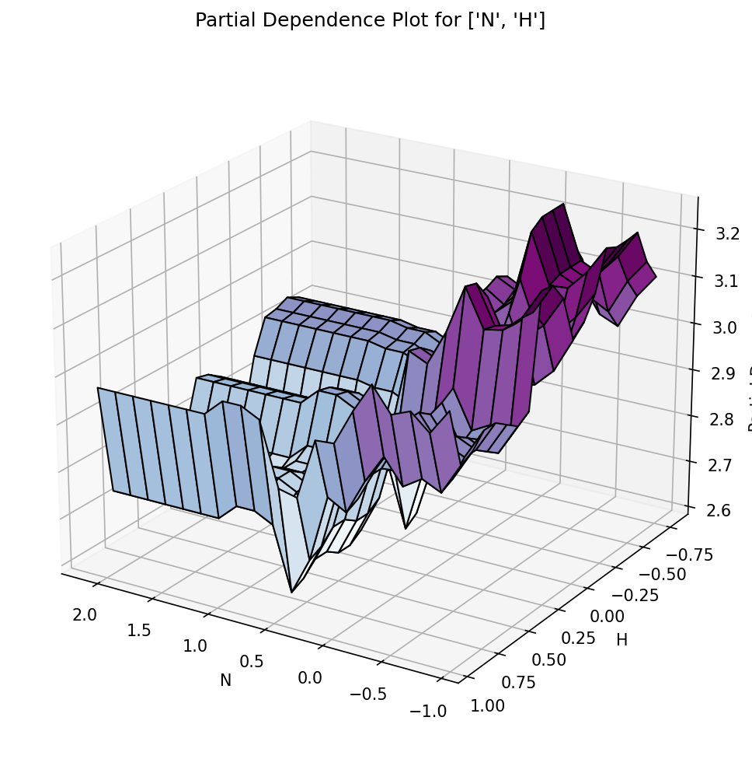
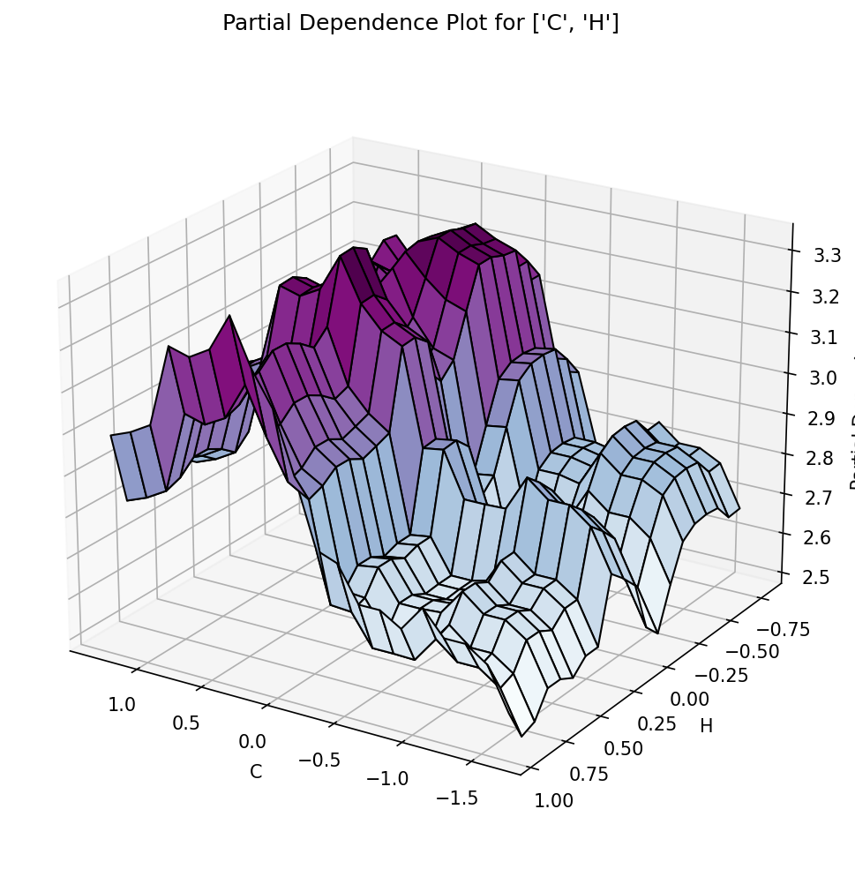
Result
Partial dependence plots

Slide 14
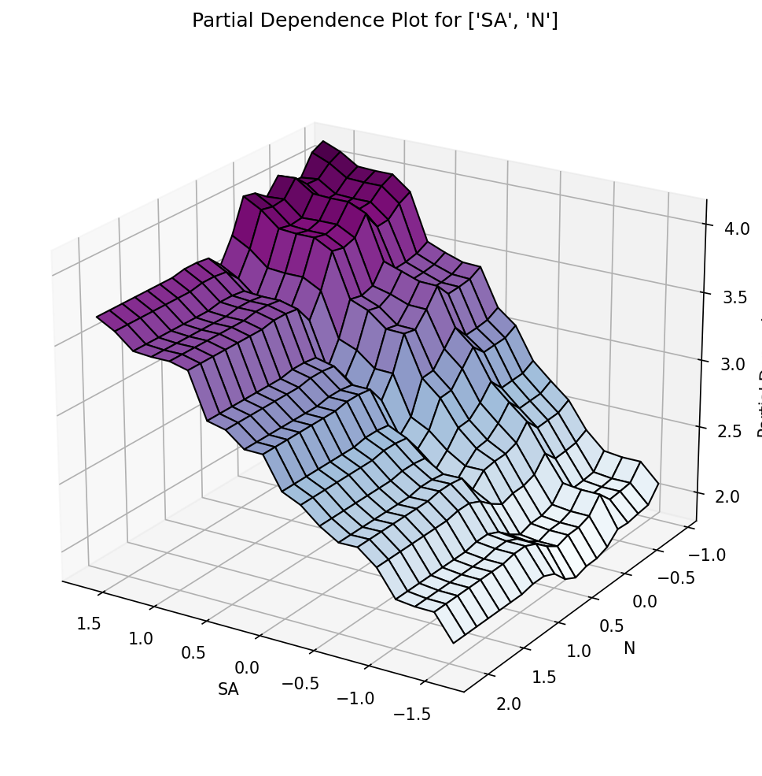
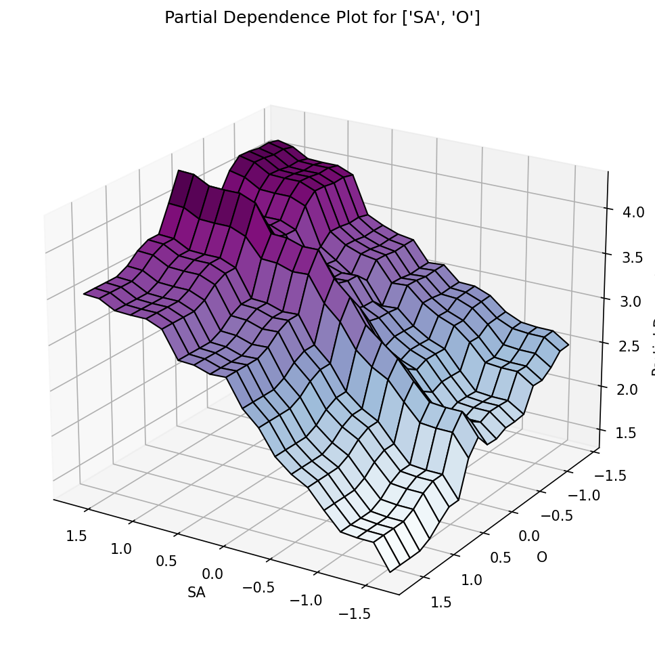
Result
Partial dependence plots

Slide 15
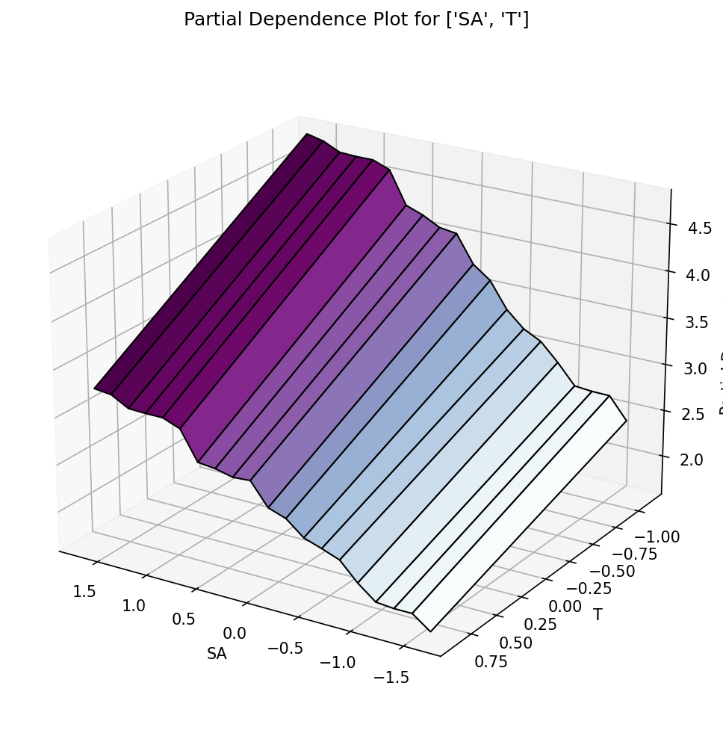
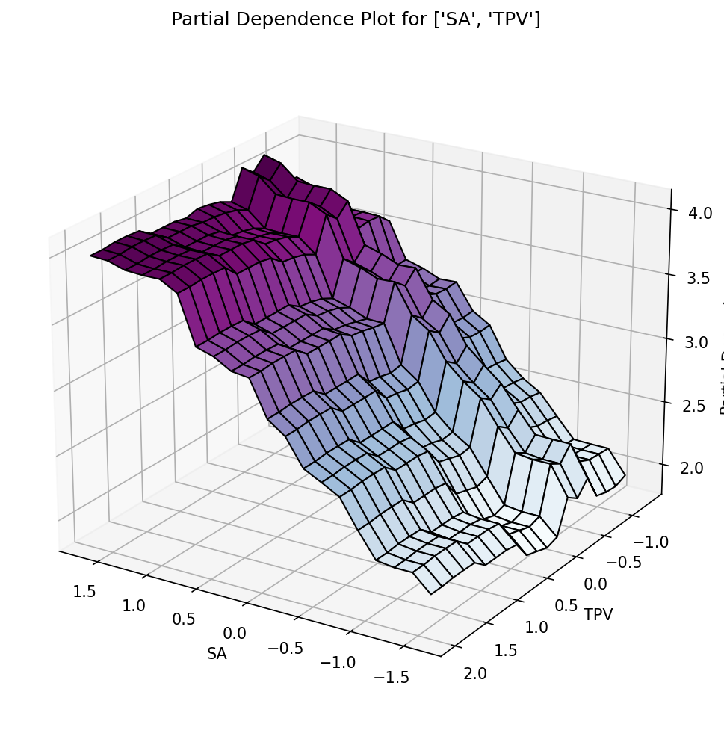
Result
Partial dependence plots

